Slide 1
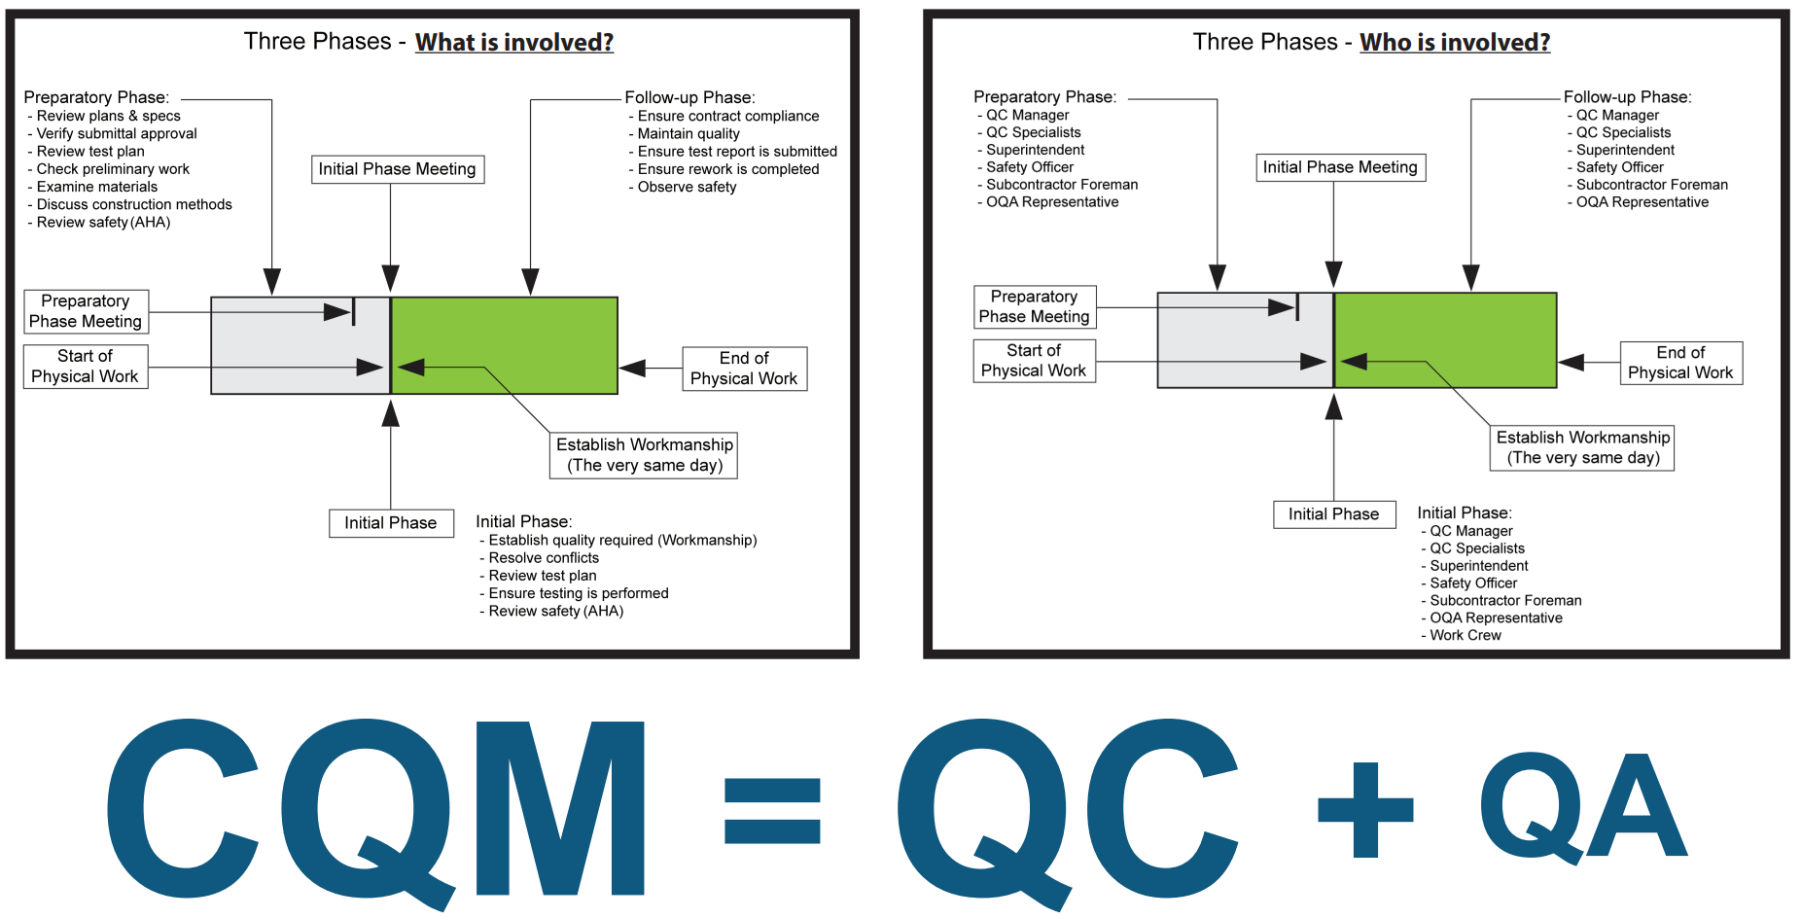
Construction Quality Management for Contractors (CQM)

Slide 2
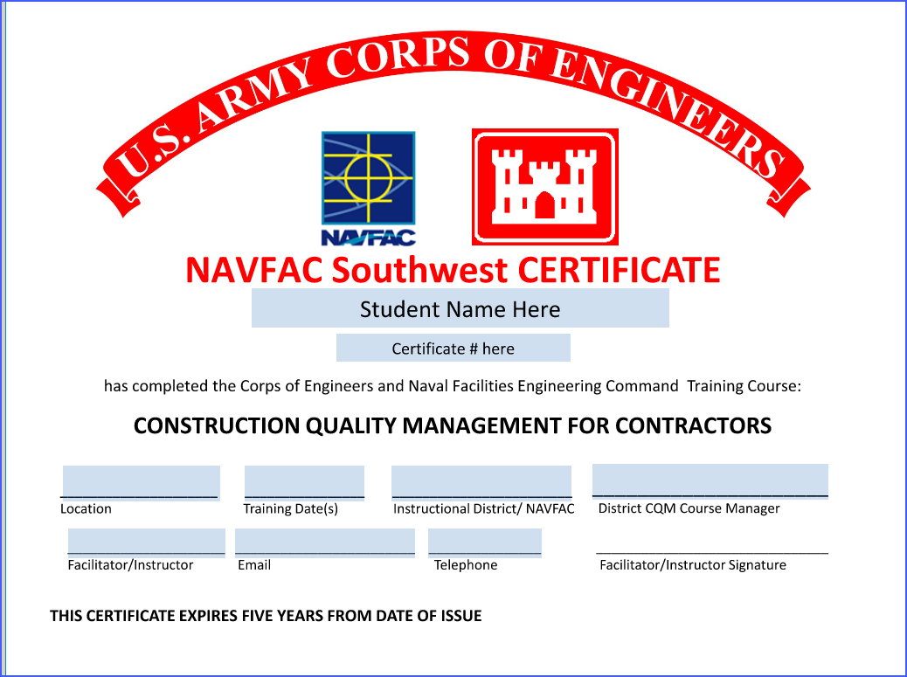
Sample Certificate of Completion
I have been given Contractor Instruction Compliance Memorandum by NAVFAC SOUTHWEST to present the training. POC: Greg Lewis; gregory.j.lewis41.civ@us.navy.mil

Slide 3
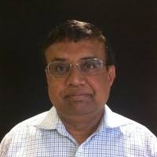
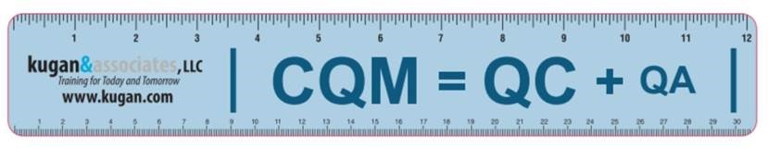
Primary Facilitator
Kugan Panchadsaram, PE, PMP
Email: kugan@kugan.com
Telephone (USA): (1) 858-212-2941
www.kugan.com/cqm

Slide 4
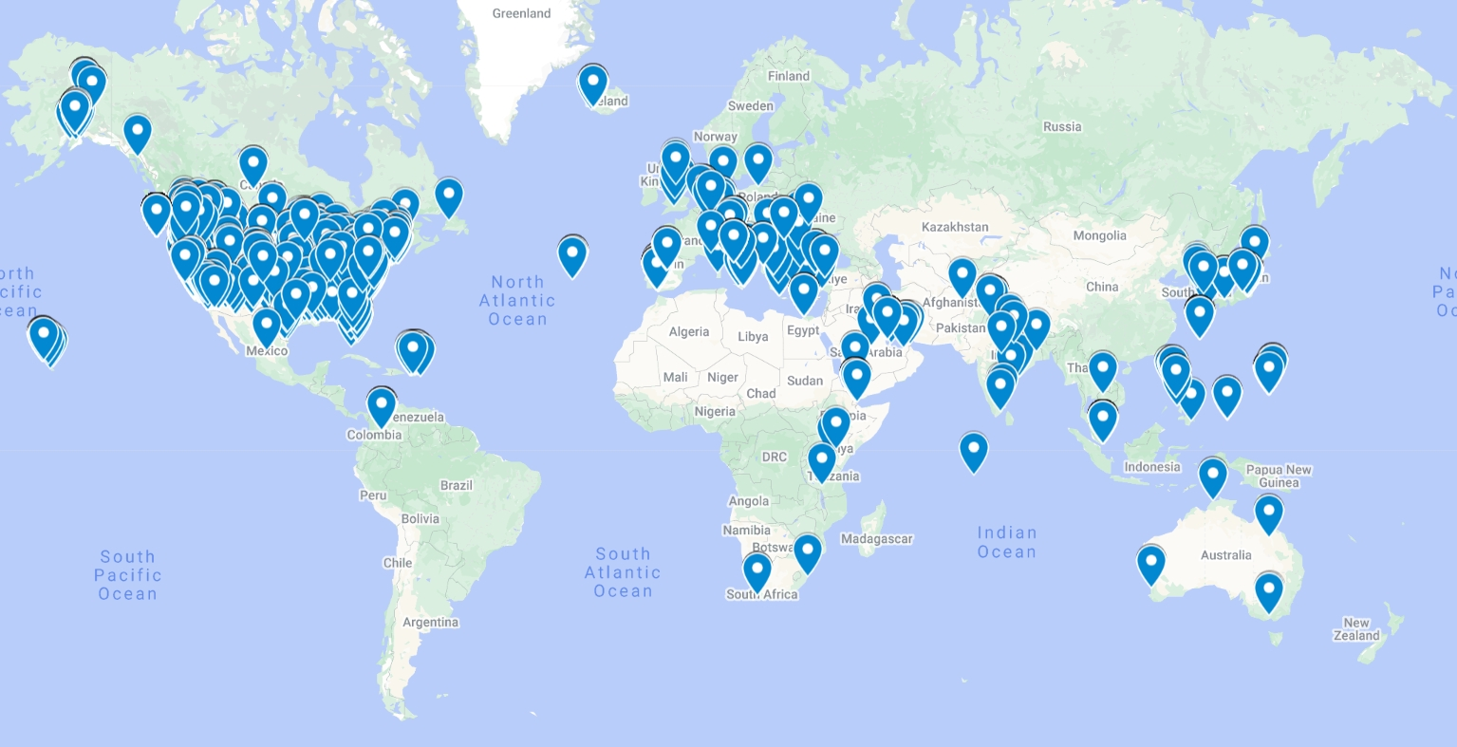
Worldwide Reach

Slide 5
MINOR DETAILS
Emergency Exits
Rest Rooms
Soda Machine
Lunch
Recycling
Special Requirements

Slide 6
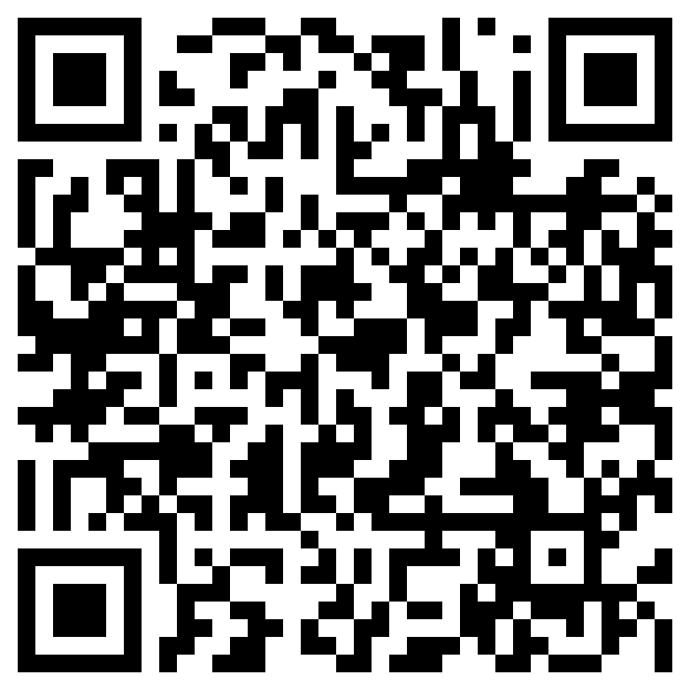
Pre-Test
https://www.proprofs.com/quiz-school/ugc/story.php?title=1819-feb-2025-cecospretest-1a1

Slide 7
One Minute Introduction!
Name
Duty Station
Position
Hobby

Slide 8
Target Audience
Construction Team
  Quality Control Manager
  SUPT
  Project Manager
Design Team
  DOR
  DQCM
GOVT QA Team
Others with condition(s)
  PE , PC. Etc…

Slide 9
Understanding “Why This Training?”
Three case studies.

Slide 10
CQM Objectives
Module 1. Introduction
Module 2. Contractor's Review
Module 3. Quality Management Planning
Module 4. Post-Award Orientation/Preconstruction
Module 5. Submittals

Slide 11
CQM Objectives
Module 6. Quality Management For Construction Projects
Module 7. Making the System Work
Module 8. Quality Control System (QCS) and Resident Management System (RMS)
Module 9. eCMS

Slide 12
Delivery Method
Multimedia Presentation
Questions and Answers
Open Discussion
Course Evaluation
Final Exam
  Multiple choices 32 out of 40 correct (Four choices)

Slide 13
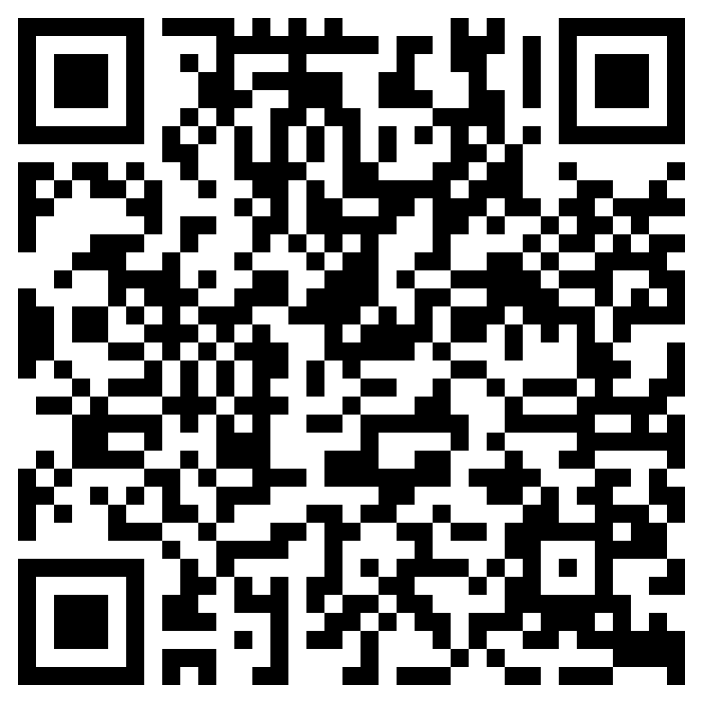
Final Exam
https://www.proprofs.com/quiz-school/ugc/story.php?title=1819-feb-2025-cecosposttest-2w2

